Slide 1
17CS44- Microprossors & Microcontrollers
Prof.S.Mahalakshmi

Slide 2
Course Outcomes
CO1: Understand the architecture and instruction set of 16bit to 64 bit microprocessors and ARM Processors.
CO2: Use the basic knowledge for interfacing various devices to x 86 families and ARM Processor
CO3: Analyze the abstract problem and provide hardware and software solutions.
CO4: Develop the skills in writing assembly language programming.
CO5: Design software and hardware programs using assembly language programming.

Slide 3
Contents
History of x86 Family
Inside the 8088/8086,
Introduction to assembly programming
Introduction to program segments
The stack, Flag register
X86 Addressing modes

Slide 4
Defintion
A microprocessor is a computer processor on a microchip that incorporates the functions of a central processing unit
It is sometimes called a logic chip
It is designed to perform arithmetic and logic operations that make use of small number-holding areas called registers

Slide 5
History of x86 family
World’s first microprocessor Intel 4004 was a 4 bit microprocessor with 12 bit address lines.
In 1972 8 bit version 8008 was announced with expanded memory size upto 16K bytes

Slide 6
History of X86 continues..
In 1978, Intel Corporation introduced the 16-bit 8086 microprocessor, a major improvement over the previous generation 8080/8085 series.
The 8086 capacity of 1 megabyte of memory exceeded the 8080/8085 maximum of 64K bytes of memory.
8080/8085 was an 8-bit system, which could work on only 8 bits of data at a time.
Data larger than 8 bits had to be broken into 8-bit pieces to be processed by the CPU.
8086 was a pipelined processor, as opposed to the
nonpipelined 8080/8085.

Slide 7
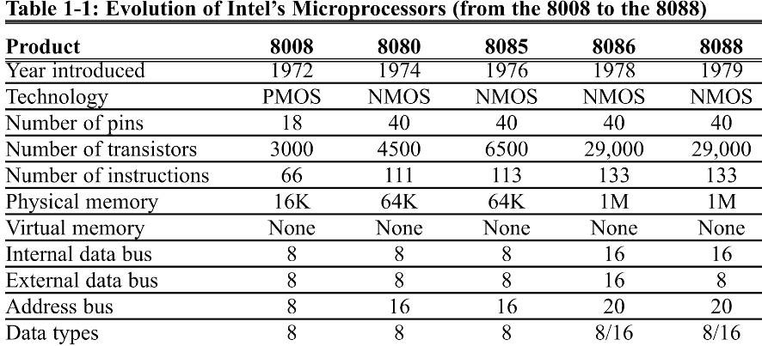
Evolution of Intel’s Microprocessors (from 8008 to 8088)

Slide 8
Comparison of 8085 with 8086
Sl.No | Intel 8085 | Intel 8086/8088
1. | 8-bit non pipelined microprocessor | 16-bit pipelined microprocessors
2. | Addressed 64K bytes of memory | Addressed 1 Mbytes ( 1Mbyte=1024Kbytes = 1024*1024 bytes =1,048,576bytes) of memory
3. | Can execute 769,230 instructions per second | Executed 2.5 MIPs (millions of instructions per second)
4. | Its instruction set contained 246 instructions | Its instruction set contained over 20,000 instructions
5 | Address lines: 16, Data bus: 8 | Address lines: 20, Data bus: 16
6 | No Coprocessor | It has Coprocessor(8087)

Slide 9
8086: 80486
The Intel 80286
Designed to use CPU in multiuser microprocessor
16-bit internal and external data buses
24 address lines; which give 16M bytes of memory (2²⁴=16Mbytes)
The clock speed of 80286 was increased; hence, it executed 4MIPs
»Virtual memory–swapping data between diskstorage and RAM
»The 80286 can operate in one of two modes: realmode and protectedmode

Slide 10
The Intel 80386
Internally and externally a 32-bit microprocessor
32 bit address bus; capable of handling physical memory of upto 4 gigabytes (2³²=4G bytes)
Virtual memory was increased to 64 terabytes (2⁴⁶ = 64 T bytes)
The Intel 80386SX
Internally identical to 80386,microprocessor
24-bit address bus, which gives a capacity of 16Mbytes (2²⁴=16Mbytes) of memory
16-bit external data bus – This makes the 386SX system much cheaper
MP, CSE, VCET

Slide 11
The Intel 80486
The 80486 is available as an 80486DX (contains the numeric coprocessor), or an 80486SX( does not contain numeric coprocessor)
Executes many of 80386 instructions in one clock period
80486 microprocessor improved 80386 numeric coprocessor
80486 microprocessor also contains an cache memory
The 80486DX contains a16K byte cache memory
When the 80486 is operated at the same clock frequency as an 80386, it performs with about a 50% speed improvement
The 80486 is available as a 25MHz, 33MHz, 50MHz, 66MHz, or 100MHzdevice
Note that, all programs written for the 8088/86 will run on 286, 386, and 486 computers

Slide 12
Evolution of μ processor from 8086 to 80486
Product | 8086 | 80286 | 80386 | 80486
Year Introduced | 1978 | 1982 | 1985 | 1989
Technology | NMOS | NMOS | CMOS | CMOS
Clock rate(MHz) | 3-10 | 10-16 | 16-33 | 25-33
No of Pins | 40 | 68 | 132 | 168
No of Transistors | 29000 | 134,000 | 275,000 | 1.2 mill.
Physical Memory | 1M | 16M | 4G | 4G
Virtual Memory | None | 1G | 64T | 64T
Internal Data Bus | 16 | 16 | 32 | 32
External Data Bus | 16 | 16 | 32 | 32
Address Bus | 20 | 24 | 32 | 32
Data Types | 8/16 | 8/16 | 8/16/32 | 8/16/32

Slide 13
Evolution of μ processor from pentium to pentium 4
The Intel Pentium
Sub micron fabrication technology–more than 3 million transistors
The Pentium had speeds of 60 and 66MHz (twice that of 80486 and over 300times faster than that of the original 8088)
Separate 8K cache memory for code and data
64-bit external data bus with 32-bit register and 32-bit address bus capable of addressing 4G bytes of memory
Improved floating-point processor
Pentium is packaged in a 273-pin PGA chip
A dual-integer processor can execute 2 instructions at a time
It uses BICMOS technology, which combines the speed of bipolar transistor swith the power efficiency of CMOS technology

Slide 14
The Intel Pentium Pro
Sixth generation of the x86 family
Pentium Pro is an enhanced version of Pentium that uses 5.5 million transistors
It was designed to be used for 32-bit servers and workstations.

Slide 15
Product | Pentium | Pentium Pro
Year Introduced | 1993 | 1995
Technology | BICMOS | BICMOS
Clock rate(MHz) | 60,66 | 150
No of Pins | 273 | 387
No of Transistors | 3.1mill. | 5.5 mill.
Physical Memory | 4 G | 64G
Virtual Memory | 64T | 64T
Internal Data Bus | 32 | 32
External Data Bus | 64 | 64
Address Bus | 32 | 36
Data Types | 8/16/32 | 8/16/32

Slide 16
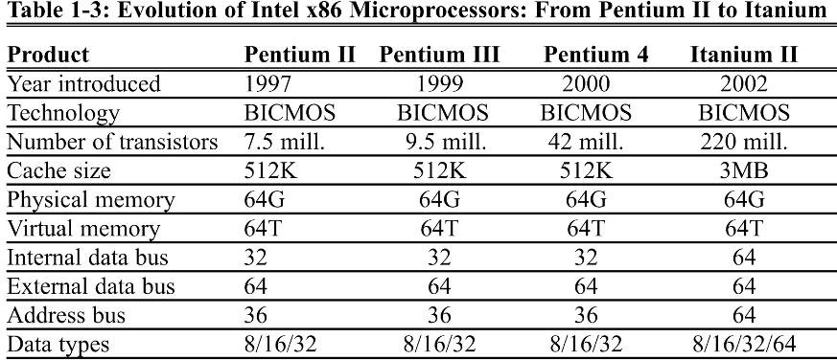
Evolution of μ processor from pentium to pentium 4

Slide 17
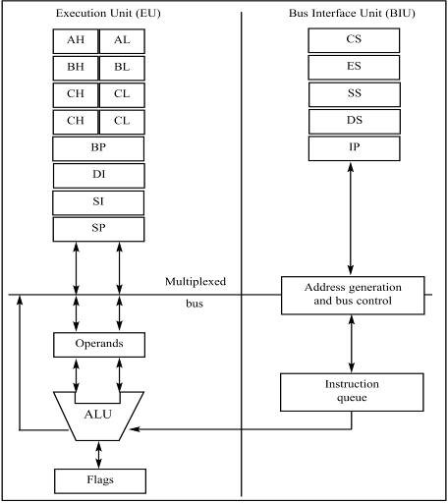
1.2 Inside 8088/8086
There are two ways to make the CPU process information faster:
Increase the working frequency.
Using technology available, with cost considerations.
Change the internal architecture of the CPU.
Internal Block Diagram of the 8088/86 CPU

Slide 18
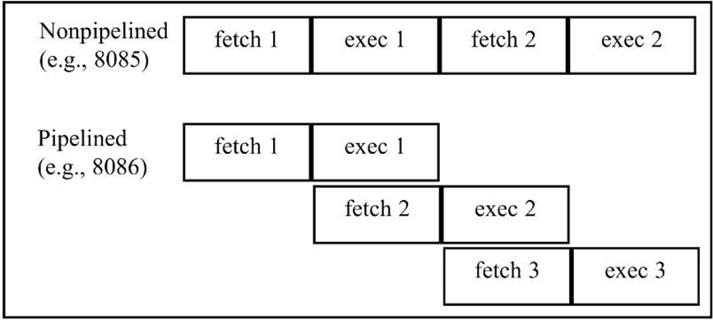
pipelining
8085 could fetch or execute at any given time.
– The idea of pipelining in its simplest form is to allow the CPU to fetch and execute at the same time.
Pipelined vs Nonpipelined Execution

Slide 19
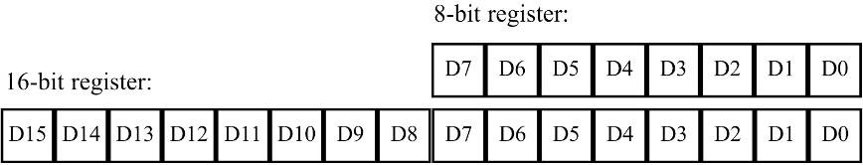
registers
In the CPU, registers store information temporarily.
One or two bytes of data to be processed.
The address of data.
General-purpose registers in 8088/86 processors can be accessed as either 16-bit or 8-bit registers
All other registers can be accessed only as the full 16 bits.
In 8088/86, data types are either 8 or 16 bits
To access 12-bit data, for example, a 16-bit register must be used with the highest 4 bits set to 0.
The bits of a register are numbered in descending order, as shown:

Slide 20
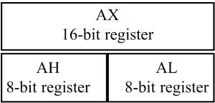
The first letter of each register indicates its use.
AX is used for the accumulator.
BX is a base addressing register.
CX is a counter in loop operations.
DX points to data in I/O operations

Slide 21
1.3 INTRODUCTION TO ASSEMBLY PROGRAMMING
The CPU can work only in binary, very high speeds.
It is tedious & slow for humans to deal with 0s & 1s in order to program the computer.
A program of 0s & 1s is called machine language.
Early computer programmers actually coded programs in machine language.
Eventually, Assembly languages were developed, which provided mnemonics for machine code.
Mnemonic is typically used in computer science and engineering literature to refer to codes & abbreviations that are relatively easy to remember.

Slide 22
Assembly language is referred to as a low-level language because it deals directly with the internal structure of the CPU.
Assembly language programs must be translated into machine code by a program called an assembler.
To program in Assembly language, programmers must know the number of registers and their size.
As well as other details of the CPU.

Slide 23
assembly language programming
An Assembly language program consists of a series of lines of Assembly language instructions.
An Assembly language instruction consists of a mnemonic, optionally followed by one or two operands.
Operands are the data items being manipulated.
Mnemonics are commands to the CPU, telling it what to do with those items.
Two widely used instructions are move & add.

Slide 24
Mov instruction
The MOV instruction copies data from one location to another, using this format:
This instruction tells the CPU to move (in reality, copy) the source operand to the destination operand.
For example, the instruction "MOV DX,CX" copies the contents of register CX to register DX.
After this instruction is executed, register DX will have the same value as register CX.

Slide 25
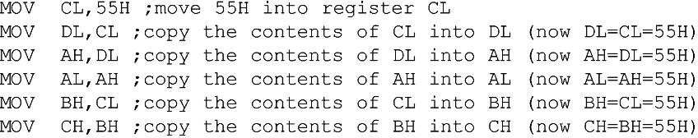
This program first loads CL with value 55H, then moves this value around to various registers inside the CPU

Slide 26
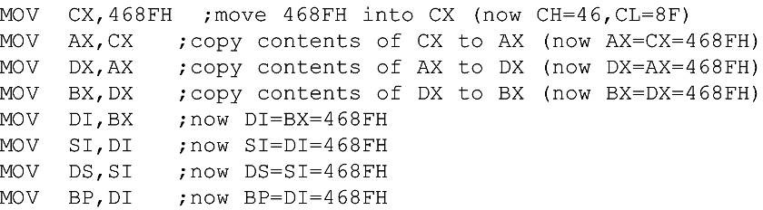
The use of 16-bit registers is shown here:

Slide 27
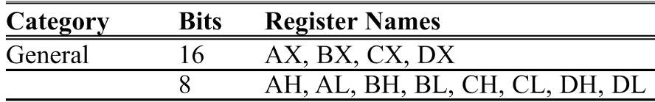
In the 8086 CPU, data can be moved among all the registers, as long as the source and destination registers match in size (Except the flag register.)
There is no such instruction as "MOV FR,AX“.
Code such as "MOV AL,DX" will cause an error.
One cannot move the contents of a 16-bit register into an 8-bit register.

Slide 28
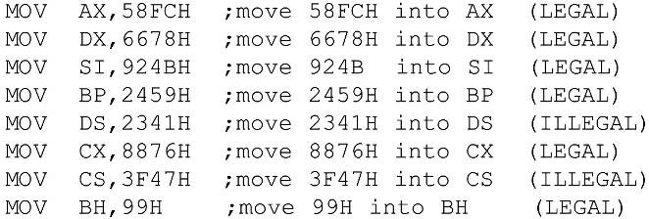
Using the MOV instruction, data can be moved directly into nonsegment registers only.
The following demonstrates legal & illegal instructions

Slide 29
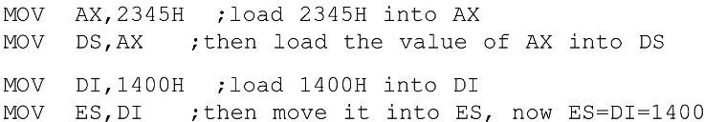
Values cannot be loaded directly into any segment register (CS, DS, ES, or SS).
– To load a value into a segment register, load it to a non- segment register, then move it to the segment register.

Slide 30
If a value less than FFH is moved into a 16-bit register, the rest of the bits are assumed to be zeros.
For example, in "MOV BX,5" the result will be BX = 0005.
BH = 00 and BL = 05.
Moving a value that is too large into a register will cause an error.

Slide 31
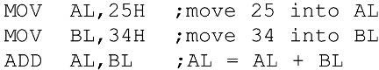
ADD instruction
The ADD instruction has the following format:
ADD tells the CPU to add the source & destination operands and put the result in the destination.
To add two numbers such as 25H and 34H, each can be moved to a register, then added together:
Executing the program above results in:
AL = 59H (25H + 34H = 59H) and BL = 34H.
The contents of BL do not change.

Slide 32
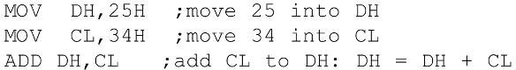
The program above can be written in many ways, depending on the registers used, such as:
The program above results in DH = 59H and CL = 34H.

Slide 33
Is it necessary to move both data items into registers before adding them together?
No, it is not necessary.
In the case above, while one register contained one value, the second value followed the instruction as an operand.
This is called an immediate operand.

Slide 34
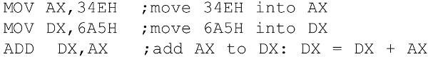
An 8-bit register can hold numbers up to FFH.
For numbers larger than FFH (255 decimal), a 16-bit register such as AX, BX, CX, or DX must be used.
The following program can add 34EH & 6A5H:
Running the program gives DX = 9F3H.
(34E + 6A5 = 9F3) and AX = 34E.
Any 16-bit nonsegment registers could have been used to perform the action above:
The general-purpose registers are typically used in arithmetic operations
Register AX is sometimes referred to as the accumulator.

Slide 35
1.4 INTRODUCTION TO PROGRAM SEGMENTS
A typical Assembly language program consists of at least three segments:
A code segment - which contains the Assembly language instructions that perform the tasks that the program was designed to accomplish.
A data segment - used to store information (data) to be processed by the instructions in the code segment.
A stack segment - used by the CPU to store information temporarily.
In literature concerning 8086, there are three types of addresses mentioned frequently:
The physical address - the 20-bit address actually on the address pins of the 8086 processor, decoded by the memory interfacing circuitry.
This address can have a range of 00000H to FFFFFH.
An actual physical location in RAM or ROM within the 1 mb memory range.
The offset address - a location in a 64K-byte segment range, which can can range from 0000H to FFFFH.
The logical address - which consists of a segment value and an offset address.

Slide 36
code segment
To execute a program, 8086 fetches the instructions (opcodes and operands) from the code segment.
The logical address of an instruction always consists of a CS (code segment) and an IP (instruction pointer), shown in CS:IP format.
The physical address for the location of the instruction is generated by shifting the CS left one hex digit, then adding it to the IP.
IP contains the offset address.
The resulting 20-bit address is called the physical address since it is put on the external physical address bus pins.

Slide 37
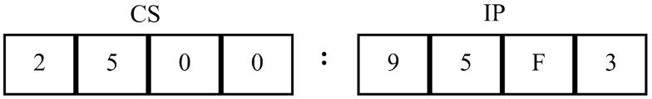
Assume values in CS & IP as shown in the diagram
The offset address contained in IP, is 95F3H.
The logical address is CS:IP, or 2500:95F3H.
The physical address will be 25000 + 95F3 = 2E5F3H

Slide 38
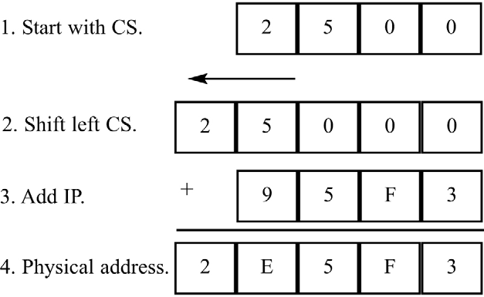
Calculate the physical address of an instruction
The microprocessor will retrieve the instruction from memory
locations starting at 2E5F3.
Since IP can have a minimum value of 0000H and a maximum of FFFFH, the logical address range in this example is 2500:0000 to 2500:FFFF.

Slide 39
Finding the lowest and highest memory location
This means that the lowest memory location of the code segment above will be 25000H (25000 + 0000) and the highest memory location will be 34FFFH (25000 + FFFF).

Slide 40
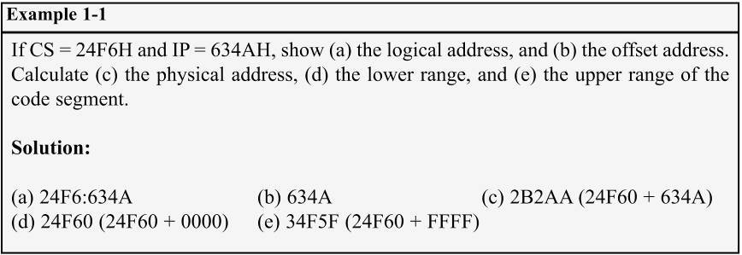
What happens if the desired instructions are located beyond these two limits?
– The value of CS must be changed to access those instructions.

Slide 41
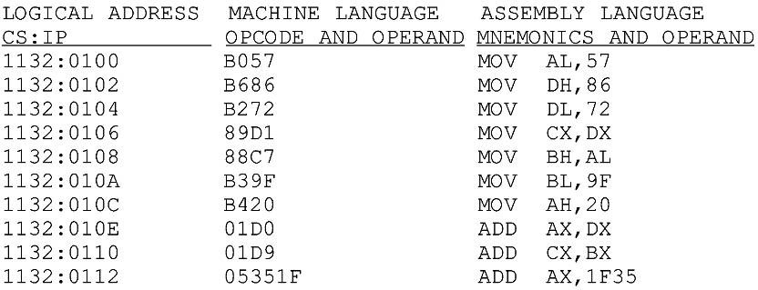
The three columns show the logical address of CS:IP, the machine code stored at that address, and the corresponding Assembly language code.
Instruction "MOV AL,57" has a machine code of B057. B0 is the opcode and 57 is the operand.

Slide 42
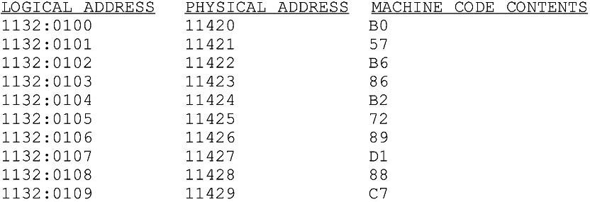
Instruction "MOV AL,57" has a machine code of B057. B0 is the opcode and 57 is the operand.
The byte at address 1132:0100 contains B0, the opcode for moving a value into register AL.
Address 1132:0101 contains the operand to be moved to AL.

Slide 43
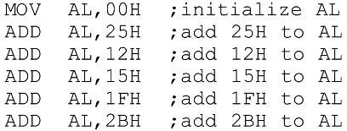
data segment
Assume a program to add 5 bytes of data, such as 25H, 12H, 15H, 1FH, and 2BH.
One way to add them is as follows
In the program above, the data & code are mixed together in the instructions.
If the data changes, the code must be searched for every place it is included, and the data retyped
From this arose the idea of an area of memory strictly for data

Slide 44
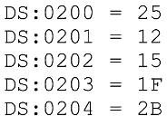
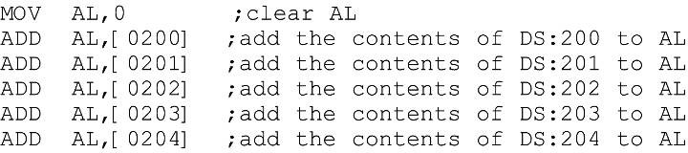
Assume data segment offset begins at 200H.
The data is placed in memory locations:
The program can be rewritten as follows:

Slide 45
The offset address is enclosed in brackets, which indicate that the operand represents the address of the data and not the data itself.
If the brackets were not included, as in
"MOV AL,0200", the CPU would attempt to move 200 into AL instead of the contents of offset address 200. decimal.
This program will run with any set of data.
Changing the data has no effect on the code.

Slide 46
If the data had to be stored at a different offset address the program would have to be rewritten
A way to solve this problem is to use a register to hold the offset address, and before each ADD, increment the register to access the next byte.
8088/86 allows only the use of registers BX, SI, and DI as offset registers for the data segment
The term pointer is often used for a register holding an offset address.

Slide 47
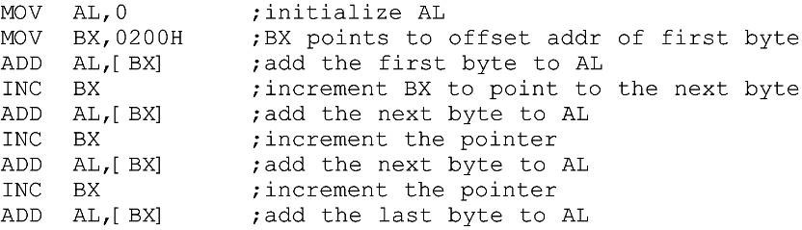
In the following example, BX is used as a pointer:
The INC instruction adds 1 to (increments) its operand.
"INC BX" achieves the same result as "ADD BX,1“
If the offset address where data is located is changed, only one instruction will need to be modified.

Slide 48
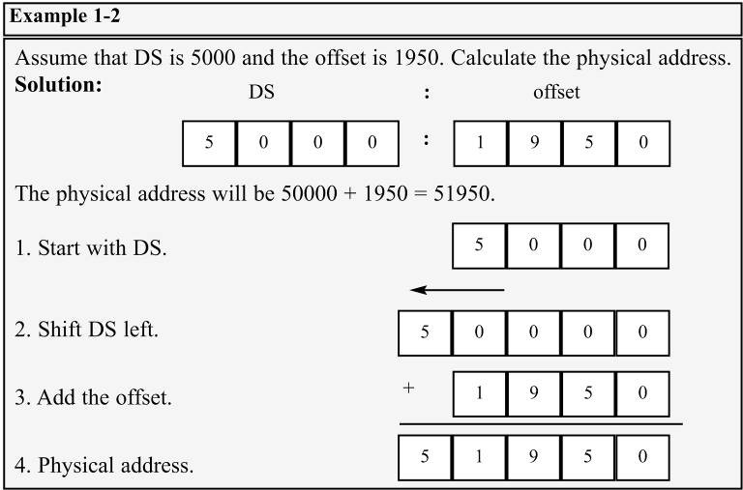
data segment logical/physical address
The physical address for data is calculated using the same rules as for the code segment.

Slide 49
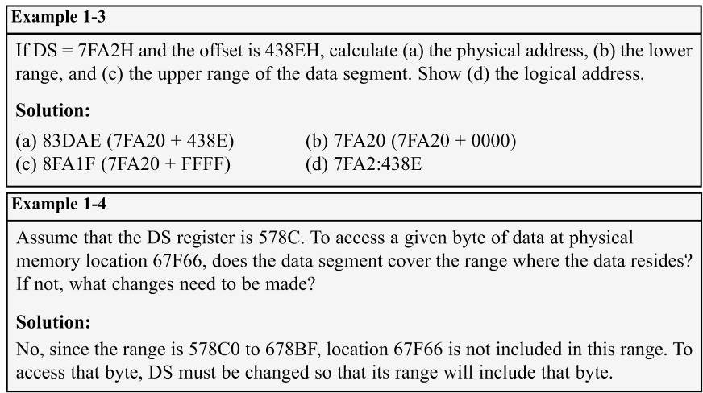

Slide 50
little endian convention
Previous examples used 8-bit or 1-byte data.
What happens when 16-bit data is used?
The low byte goes to the low memory location and the high byte goes to the high memory address.
Memory location DS:1500 contains F3H.
Memory location DS:1501 contains 35H.
(DS:1500 = F3 DS:1501 = 35)
This convention is called little endian vs big endian.
From a Gulliver’s Travels story about how an egg should be opened—from the little end, or the big end.

Slide 51
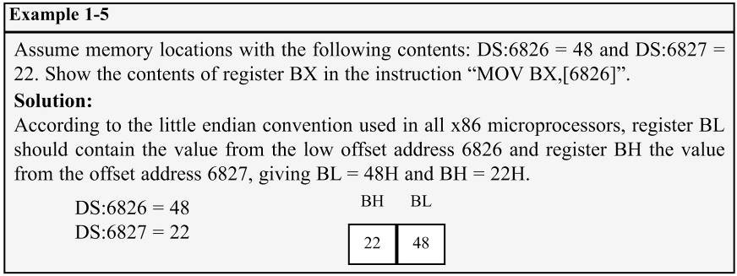
In the big endian method, the high byte goes to the low address.
– In the little endian method, the high byte goes to the high address and the low byte to the low address.

Slide 52
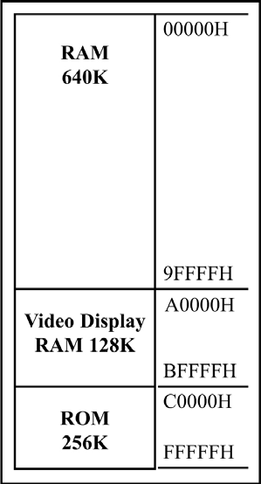
extra segment (ES)
ES is a segment register used as an extra data segment.
In many normal programs this segment is not used.
Use is essential for string operations
The 20-bit address of 8088/86 allows 1mb (1024K bytes) of memory space with the address range 00000–FFFFF.
During the design phase of the first IBM PC, engineers had to decide on the allocation of the 1-megabyte memory space to various sections of the PC.
This memory allocation is called a memory map.

Slide 53
memory map of the IBM PC
Of this 1 megabyte, 640K bytes from addresses 00000–9FFFFH were set aside for RAM
128K bytes A0000H– BFFFFH
were allocated for video memory
The remaining 256K bytes from C0000H–FFFFFH were set aside for ROM
The 640K bytes from 00000 to 9FFFFH is referred to as conventional memory.
The 384K bytes from A0000H to FFFFFH are called
the UMB (upper memory block).

Slide 54
1.5 THE STACK
what is a stack? why is it needed?
The stack is a section of read/write memory (RAM) used by the CPU to store information temporarily.
The CPU needs this storage area since there are only a limited number of registers.
There must be some place for the CPU to store information safely and temporarily.
The main disadvantage of the stack is access time.
Since the stack is in RAM, it takes much longer to access compared to the access time of registers.
Some very powerful (expensive) computers do not have a stack.
The CPU has a large number of registers to work with.

Slide 55
how stacks are accessed
The stack is a section of RAM, so there must be registers inside the CPU to point to it.
The SS (stack segment) register.
The SP (stack pointer) register.
These registers must be loaded before any instructions accessing the stack are used.
Every register inside the x86 can be stored in the stack, and brought back into the CPU from the stack memory, except segment registers and SP.
Storing a CPU register in the stack is called a push.
Loading the contents of the stack into the CPU register is called a pop.

Slide 56
The x86 stack pointer register (SP) points at the current memory location used as the top of the stack.
As data is pushed onto the stack it is decremented.
As data is popped off the stack into the CPU, it is
incremented.
When an instruction pushes or pops a general- purpose register, it must be the entire 16-bit register.
One must code "PUSH AX".
There are no instructions such as "PUSH AL" or "PUSH AH".

Slide 57
The SP is decremented after the push is to make sure the stack is growing downward from upper addresses to lower addresses.
The opposite of the IP. (instruction pointer)
To ensure the code section & stack section of the program never write over each other, they are located at opposite ends of the RAM set aside for the program.
They grow toward each other but must not meet.
If they meet, the program will crash.

Slide 58
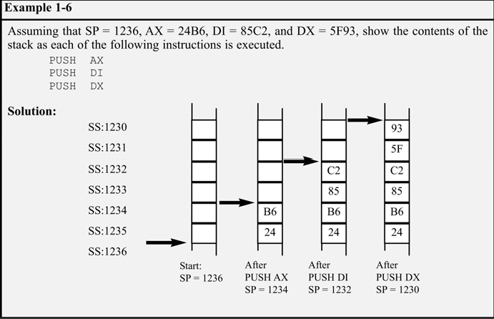
pushing onto the stack
As each PUSH is executed, the register contents are saved on the stack and SP is decremented by 2.

Slide 59
For every byte of data saved on the stack, SP is decremented once.
Since the push
is saving the contents of
a 16-bit register, it decrements
twice.

Slide 60
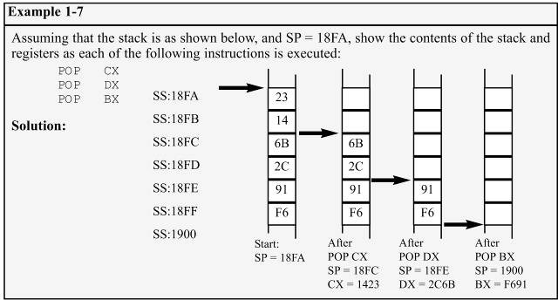
popping the stack
With every pop, the top 2 bytes of the stack are copied to the x86 CPU register specified by the instruction & the stack pointer is incremented twice.
While the data actually remains in memory, it is not accessible, since the stack pointer, SP is beyond that point.

Slide 61
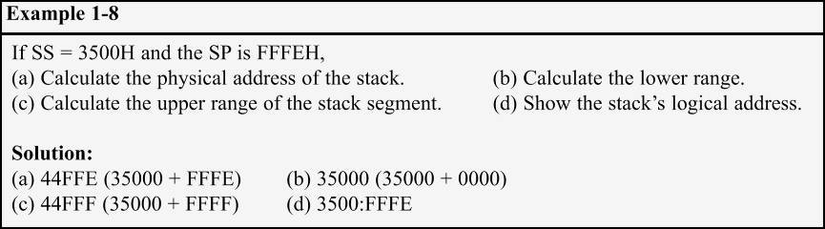
logical vs physical stack address
The exact physical location of the stack depends on the value of the stack segment (SS) register and SP, the stack pointer.
To compute physical addresses for the stack, shift left SS, then add offset SP, the stack pointer register.
Windows assigns values for the SP and SS.

Slide 62
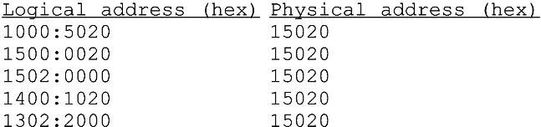
Can a single physical address belong to many different logical addresses?
Observe the physical address value of 15020H.
Many possible logical addresses represent this single physical address:
An illustration of the dynamic behavior of the segment and offset concept in the 8086 CPU.

Slide 63
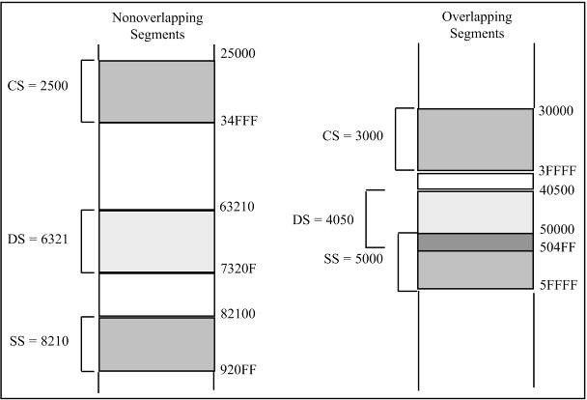
overlapping
In calculating the physical address, it is possible that two segments can overlap.

Slide 64
1.6 FLAG REGISTER
Many Assembly language instructions alter flag register bits & some instructions function differently based on the information in the flag register.
The flag register is a 16-bit register sometimes referred to as the status register.
Although 16 bits wide, only some of the bits are used.
The rest are either undefined or reserved by Intel.

Slide 65
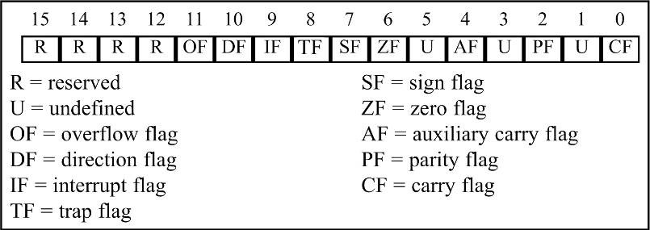
Six flags, called conditional flags, indicate some condition resulting after an instruction executes.
These six are CF, PF, AF, ZF, SF, and OF.
The remaining three, often called control flags, control the operation of instructions before they are executed

Slide 66
bits of the flag register
CF (Carry Flag) - Set when there is a carry out, from d7 after an 8-bit operation, or d15 after a 16-bit operation.
Used to detect errors in unsigned arithmetic operations.
PF (Parity Flag) - After certain operations, the parity of the result's low-order byte is checked.
If the byte has an even number of 1s, the parity flag is set to 1; otherwise, it is cleared.
AF (Auxiliary Carry Flag) - If there is a carry from d3 to d4 of an operation, this bit is set; otherwise, it is cleared.
Used by instructions that perform BCD (binary coded decimal) arithmetic.

Slide 67
ZF (Zero Flag) - Set to 1 if the result of an arithmetic or logical operation is zero; otherwise, it is cleared.
SF (Sign Flag) - Binary representation of signed numbers uses the most significant bit as the sign bit.
After arithmetic or logic operations, the status of this sign bit is copied into the SF, indicating the sign of the result.
TF (Trap Flag) - When this flag is set it allows the program to single-step, meaning to execute one instruction at a time.
Single-stepping is used for debugging purposes.
IF (Interrupt Enable Flag) - This bit is set or cleared to enable/disable only external maskable interrupt requests.
DF (Direction Flag) - Used to control the direction of string operations.
OF (Overflow Flag) - Set when the result of a signed number operation is too large, causing the high-order bit to overflow into the sign bit.
Used only to detect errors in signed arithmetic operations

Slide 68
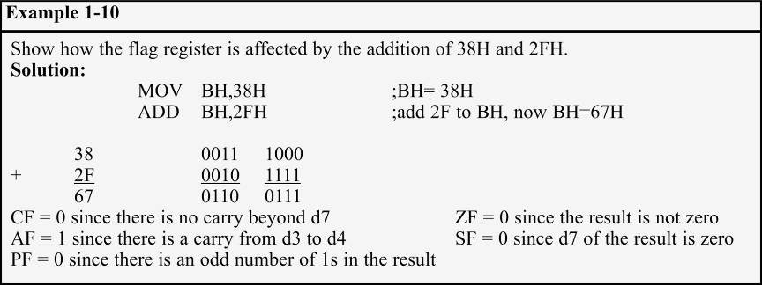
flag register and ADD instruction
Flag bits affected by the ADD instruction:
CF (carry flag); PF (parity flag); AF (auxiliary carry flag).
ZF (zero flag); SF (sign flag); OF (overflow flag).

Slide 69
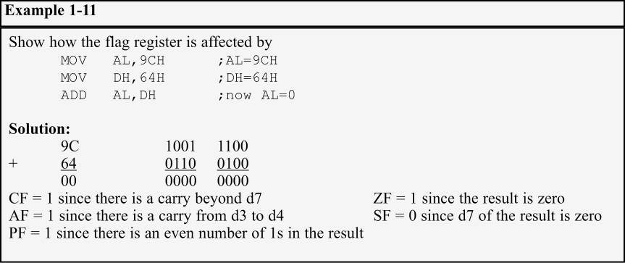

Slide 70
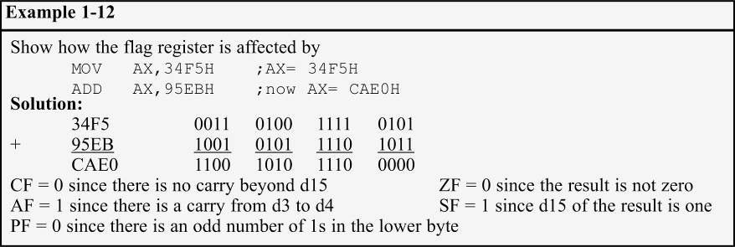
It is important to note differences between 8- and 16-bit operations in terms of impact on the flag bits.
– The parity bit only counts the lower 8 bits of the result and is set accordingly.

Slide 71
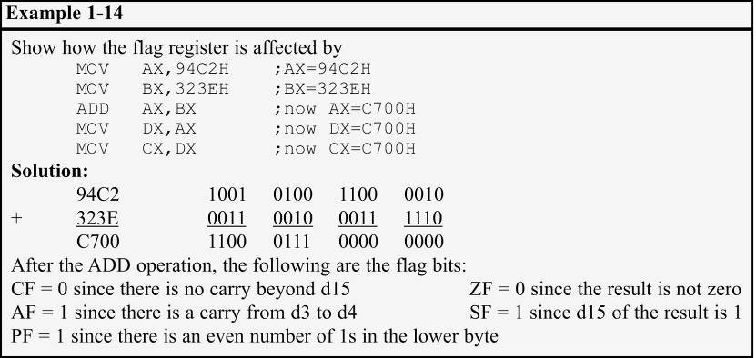
Instructions such as data transfers (MOV) affect no flags.
A widely used application of the flag register is the use of the zero flag to implement program loops.

Slide 72
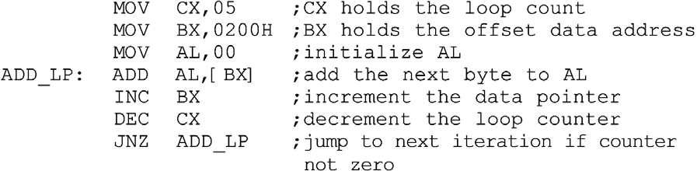
use of the zero flag for looping
As an example, to add 5 bytes of data, a counter can be used to keep track of how many times the loop needs to be repeated.
Each time the addition is performed the counter is decremented and the zero flag is checked.
When the counter becomes zero, the zero flag is set (ZF = 1) and the loop is stopped.

Slide 73
JNZ instruction must come immediately after the instruction that decrements CX.
JNZ needs to check the effect of "DEC CX" on ZF.
If any instruction were placed between them, that instruction might affect the zero flag.

Slide 74
x86 ADDRESSING MODES
The CPU can access operands (data) in various ways, called addressing modes.
– The number of addressing modes is determined when the microprocessor is designed & cannot be changed
The x86 provides seven distinct addressing modes
1 - Register
2 - Immediate
3 - Direct
4 - Register indirect
5 - Based relative
6 - Indexed relative
7 - Based indexed relative

Slide 75
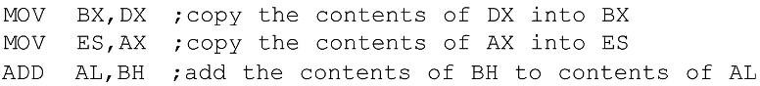
register addressing mode
Register addressing mode involves use of registers to hold the data to be manipulated.
Memory is not accessed, so it is relatively fast.
Examples of register addressing mode:
The the source & destination registers must match in size.
Coding "MOV CL,AX" will give an error, since the source is a 16-bit register and the destination is an 8-bit register.

Slide 76
immediate addressing mode
In immediate addressing mode, as the name implies, when the instruction is assembled, the operand comes immediately after the opcode.
– The source operand is a constant.
This mode can be used to load information into any of register except the segment and flag registers.
To move information to the segment registers, the data must first be moved to a general-purpose register, then to the segment register.

Slide 77
direct addressing mode
In direct addressing mode, the data is in some memory location(s).
In most programs, the data to be processed is often in some memory location outside the CPU.
The address of the data in memory comes immediately after the instruction.
The address of the operand is provided with the instruction, as an offset address.
Calculate the physical address by shifting left the DS register and adding it to the offset:
If the bracket is absent, executing the command will give an error, as it is interpreted to move the value 2400 (16-bit data) into register DL.(An 8-bit register.)

Slide 78
register indirect addressing mode
In register indirect addressing mode, the address of the memory location where the operand resides is held by a register.
The registers used for this purpose are SI, DI, and BX.
If these three registers are used as pointers, they must be combined with DS in order to generate the 20-bit physical address.
Notice that BX is in brackets.
The physical address is calculated by shifting DS left one hex position and adding BX to it.

Slide 79
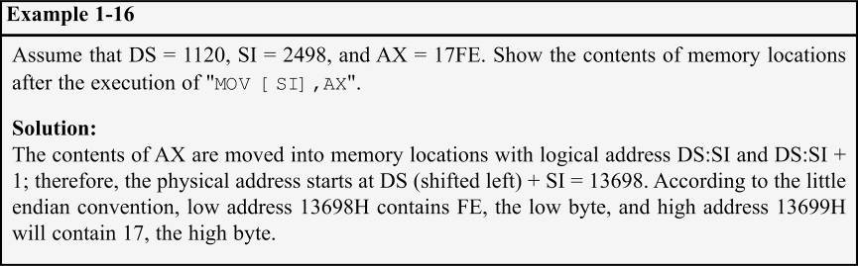
The same rules apply when using register SI or DI

Slide 80
based relative addressing mode
In based relative addressing mode, base registers BX & BP, and a displacement value, are used to calculate the effective address.
Default segments used for the calculation of the physical address (PA) are DS for BX and SS for BP.
Alternatives are "MOV CX,[BX+10]" or "MOV CX,10[BX]"
Again the low address contents will go into CL and the high address contents into CH.

Slide 81
In the case of the BP register:
Alternatives are "MOV AL,[BP+5]" or "MOV AL,5[BP]".
BP+5 is called the effective address since the fifth byte from the beginning of the offset BP is moved to register AL.

Slide 82
indexed relative addressing mode
The indexed relative addressing mode works the same as the based relative addressing mode.
– Except that registers DI & SI hold the offset address.

Slide 83
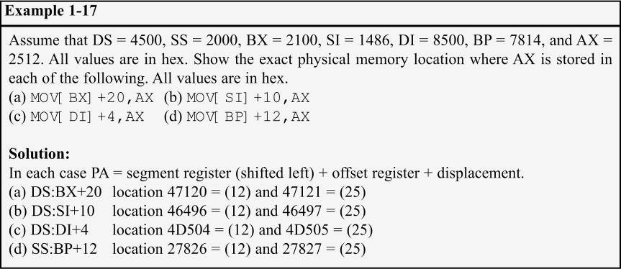

Slide 84
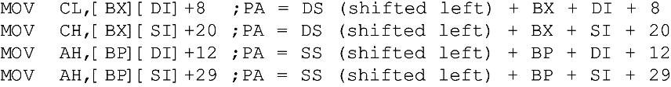
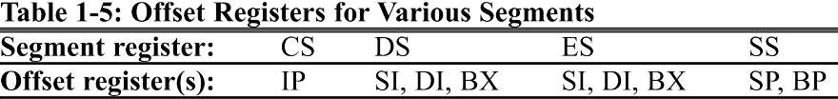
based indexed addressing mode
By combining based & indexed addressing modes, a new addressing mode is derived called the based indexed addressing mode.
One base register and one index register are used.
The coding of the instructions can vary

Slide 85
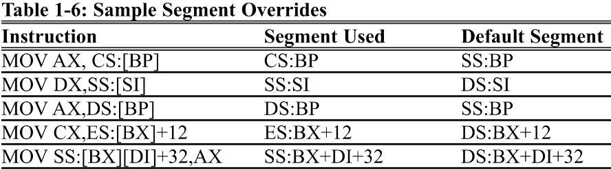
segment overrides
The x86 CPU allows the program to override the default segment and use any segment register.
In "MOV AL,[BX]", the physical address of the operand to be moved into AL is DS:BX.
To override that default, specify the desired segment in the instruction as "MOV AL,ES:[BX]"

Slide 86
Assembly language program
An Assembly language program is a series of statements, or lines.
–Either Assembly language instructions, or statements called directives.
Directives (pseudo-instructions) give directions to the assembler about how it should translate the Assembly language instructions into machine code.
Assembly language instructions consist of four fields: [label:] mnemonic [operands] [;comment]
Brackets indicate that the field is optional.
Do not type in the brackets.

Slide 87
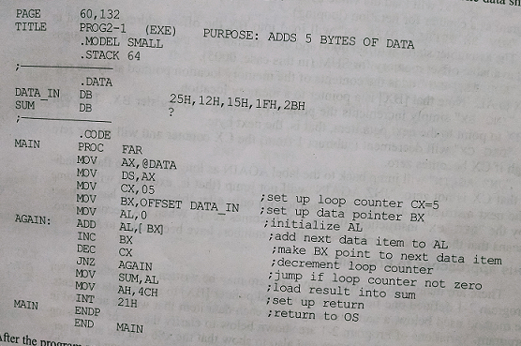
Sample Programs: to add 5 bytes of data

Slide 88
Various approach for pgm 1
; from the data segment:
DATA1 DB 25H
DATA2 DB 12H
DATA3 DB 15H
DATA4 DB 1FH
DATA5 DB 2BH
SUM DB ?
; from the code segment
MOV AL, DATA1
ADD AL, DATA2
ADD AL, DATA3
ADD AL, DATA4
ADD AL, DATA5
MOV SUM, AL

Slide 89
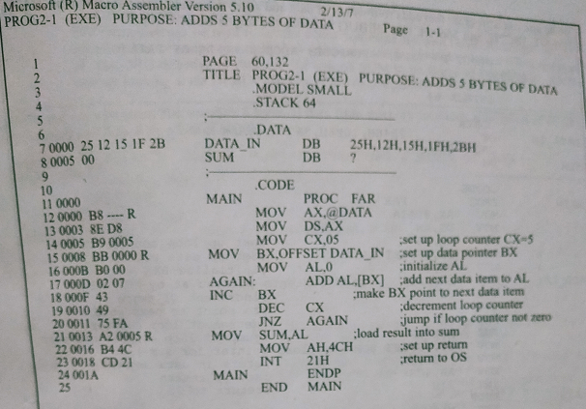

Slide 90
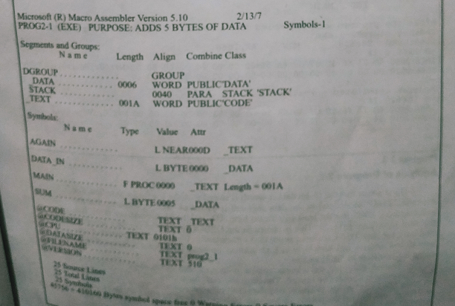
.lst file

Slide 91
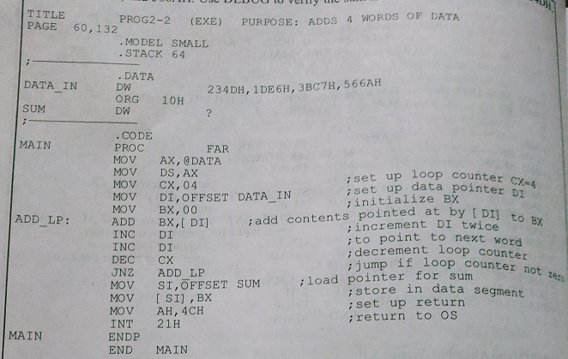
Adds 4 words of data

Slide 92
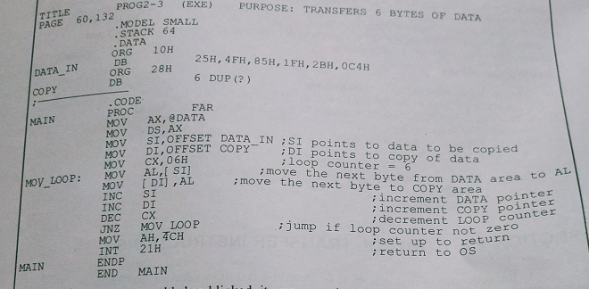
Transfer 6 bytes of data

Slide 93
1.11 Control transfer Instructions
In the sequence of instructions, it is often necessary to transfer program control to a different location.
If control is transferred to a memory location within the current code segment, it is NEAR.
Sometimes called intrasegment. (within segment)
the IP is updated and CS remains the same
If control is transferred outside the current code segment, it is a FAR jump.
Or intersegment. (between segments)
both CS and IP have to be updated to the new values

Slide 94
Conditional jumps
Conditional jumps have mnemonics such as JNZ (jump not zero) and JC (jump if carry).
In the conditional jump, control is transferred to a new location if a certain condition is met.
The flag register indicates the current condition.
For example, with "JNZ label", the processor looks at the zero flag to see if it is raised.
If not, the CPU starts to fetch and execute instructions from the address of the label.
If ZF = 1, it will not jump but will execute the next instruction below the JNZ.

Slide 95
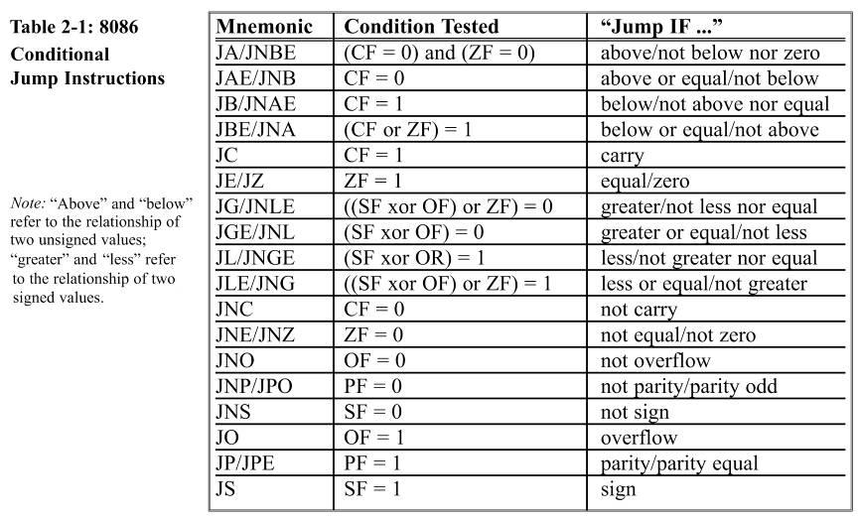
Conditional Jump Instructions

Slide 96
Short Jumps
All conditional jumps are short jumps.
The address of the target must be within -128 to +127 bytes of the IP.
The conditional jump is a two-byte instruction.
One byte is the opcode of the J condition.
The second byte is a value between 00 and FF.
An offset range of 00 to FF gives 256 possible addresses.
In a jump backward, the second byte is the 2's complement of the displacement value

Slide 97

To calculate the target address, the second byte is added to the IP of the instruction after the jump.
"JNZ AGAIN" was assembled as "JNZ 000D", and 000D is the address of the instruction with the label AGAIN.
JNZ 000D" has the opcode 75 and the target address FA.

Slide 98
This is followed by "MOV SUM,AL", which is located beginning at offset address 0013.
.
The IP value of MOV,0013, is added to FA to calculate the address of label AGAIN, and the carry is dropped.
FA is the 2's complement of -6.

Slide 99

Calculate a forward jump target address by adding the IP of the following instruction to the operand.
–The displacement value is positive, as shown.
"JB NEXT" has the opcode 72, the target address 06 and is located at IP = 000A and 000B.
The jump is 6 bytes from the next instruction, is IP = 000C.
Adding gives us 000CH + 0006H = 0012H, which is the exact address of the NEXT label.

Slide 100
For conditional jumps, the address of the target address can never be more than -128 to +127 bytes away from the IP associated with the instruction following the jump.
Any attempt is made to violate this rule will generate a "relative jump out of range" message.

Slide 101
Unconditional Jumps
An unconditional jump transfers control to the target location label unconditionally, in the following forms:
SHORT JUMP - in the format "JMP SHORT label".
A jump within -128 to +127 bytes of memory relative to the address of the current IP, opcode EB.
NEAR JUMP - the default, has the format "JMP label".
A jump within the current code segment, opcode E9.
The target address can be any of the addressing modes of direct, register, register indirect, or memory indirect:
a)Direct JUMP - exactly like the short jump.
Except that the target address can be anywhere in the segment in the range +32767 to -32768 of the current IP.

Slide 102
An unconditional jump transfers control to the target location label unconditionally, in the following forms:
b) Register indirect JUMP - target address is in a register.
In "JMP BX", IP takes the value BX.
c)Memory indirect JMP - target address is the contents of two memory locations, pointed at by the register.
"JMP [DI]" will replace the IP with the contents of memory locations pointed at by DI and DI+1.
FAR JUMP - in the format "JMP FAR PTR label". register.
A jump out of the current code segment
IP and CS are both replaced with new values.

Slide 103
CALL statements
The CALL instruction is used to call a procedure, to perform tasks that need to be performed frequently.
The target address could be in the current segment, in which case it will be a NEAR call or outside the current CS segment, which is a FAR call.
The microprocessor saves the address of the instruction following the call on the stack.
To know where to return, after executing the subroutine.
In the NEAR call only the IP is saved on the stack.
In a FAR call both CS and IP are saved.

Slide 104


For control to be transferred back to the caller, the last subroutine instruction must be RET (return).
For NEAR calls, the IP is restored.
For FAR calls, CS & IP are restored.
Assume SP = FFFEH:
Since this is a NEAR call, only IP is saved on the stack.
The IP address 0206, which belongs to the "MOV AX,142F" instruction, is saved on the stack.

Slide 105

The last instruction of the called subroutine must be a RET instruction that directs the CPU to POP the top 2 bytes of the stack into the IP and resume executing at offset address 0206.
–The number of PUSH and POP instructions (which alter the SP) must match.
For every PUSH there must be a POP

Slide 106

Shell of assembly language Subroutines

Slide 107
2.12 Data Types & Data Defintion
ORG: indicate the beginning of the offset address
DUP will duplicate a given number of characters.
DW is used to allocate memory 2 bytes (one word)
EQU associates a constant value with a data label.
Defines a constant without occupying a memory location.
EG: cons EU 20
The DD directive is used to allocate memory locations that are 4 bytes (two words) in size.
Data is converted to hex & placed in memory locations
Low byte to low address and high byte to high address.

Slide 108
DQ is used to allocate memory 8 bytes (four words) in size, to represent any variable up to 64 bits wide
DT is used for memory allocation of packed BCD numbers.
This directive allocates 10 bytes.
A maximum of 18 digits can be entered.
The "H" after the data is not needed.

Slide 109

Full segment Definition

Slide 110

Flow chart & Pseudo code
Count =5
Repeat
Add next byte
Increment Pointer
Decrement Count
Until Count =0
Store Sum

